Slide 1

Course Name :
Systems Programming
12th MAR 2023

Slide 2

IMP Note to Self
Systems Programming - V 3.0

Slide 3
IMP Note to Students
It is important to know that just login to the session does not guarantee the attendance.
Once you join the session, continue till the end to consider you as present in the class.
IMPORTANTLY, you need to make the class more interactive by responding to Professors queries in the session.
Whenever Professor calls your number / name ,you need to respond, otherwise it will be considered as ABSENT
Systems Programming - V 3.0

Slide 4
Agenda
Loaders
Basic Loader Functions
Absolute loader
Relocating loader (relative loader)
Bootstrap loader
Direct linking loader
Machine-Dependent Loader Features
Systems Programming - V 3.0

Slide 5
BASIC DEFINITION
Loading - which allocates memory location and brings the object program into memory for execution - (Loader)
Linking- which combines two or more separate object programs and supplies the information needed to allow references between them - (Linker)
Relocation - which modifies the object program so that it can be loaded at an address different from the location originally specified - (Linking Loader)
Systems Programming - V 3.0

Slide 6
ROLE OF LOADER
Source
Program
Translator
Loader
Object
Program
Object program ready for execution
Translator – Assembler/Compiler
Memory
Systems Programming - V 3.0

Slide 7
ROLE OF LOADER AND LINKER
Memory
Source
Program
Assembler
Linker
Object
Program
Object program ready for execution
Executable
Code
Loader
Systems Programming - V 3.0

Slide 8
  Source Program – Assembly Language
  Object Program - From assembler
  - Contains translated instructions and data values from the source program
  Executable Code - From Linker
  Loader - Loads the executable code to the specified memory locations and code gets executed.
Systems Programming - V 3.0

Slide 9

NEED FOR LINKING AND LOADING
Systems Programming - V 3.0

Slide 10
WE NEED…THREE PROCESSES
Loading - which allocates memory location and brings the object program into memory for execution - Loader
Linking- which combines two or more separate object programs and supplies the information needed to allow references between them - Linker
Relocation - which modifies the object program so that it can be loaded at an address different from the location originally specified - Linking Loader
Systems Programming - V 3.0

Slide 11
BASIC LOADER FUNCTIONS
A Loader is a system program that performs the loading function
It brings object program into memory and starts its execution
Systems Programming - V 3.0

Slide 12
TYPE OF LOADERS
  Absolute loader
  Relocating loader (relative loader)
  Bootstrap loader
  Direct linking loader
Systems Programming - V 3.0

Slide 13
ABSOLUTE LOADER
Operation is very simple
The object code is loaded to specified locations in the memory
At the end the loader jumps to the specified address to begin execution of the loaded program
Systems Programming - V 3.0

Slide 14
ROLE OF ABSOLUTE LOADER
Absolute
Loader
1000
Object
Program
Object program ready for execution
2000
Memory
Systems Programming - V 3.0

Slide 15
ABSOLUTE LOADER
  Advantage
    - Simple and efficient
  Disadvantage
    - The need for programmer to specify the
    actual address
    - difficult to use subroutine libraries
    We have algorithm – next slide
Systems Programming - V 3.0

Slide 16
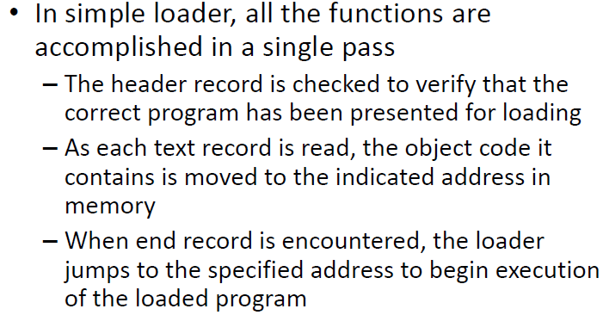
Absolute Loader
Systems Programming - V 3.0

Slide 17
Absolute Loader
For a simple absolute loader, all functions are accomplished in a single pass as follows:
1) The Header record of object programs is checked to verify that the correct program has been presented for loading.
2) As each Text record is read, the object code it contains is moved to the indicated address in memory.
3) When the End record is encountered, the loader jumps to the specified address to begin execution of the loaded program
Systems Programming - V 3.0

Slide 18
Advantages and disadvantages of absolute loader
The advantage of absolute loader is that it is simple and efficient, but the need for programmer to specify the actual address restricts the flexibility.
As a result we cannot run several independent programs together, sharing memory between them.
Another disadvantage is that it is difficult to use subroutine libraries while using an absolute loader.
Systems Programming - V 3.0

Slide 19
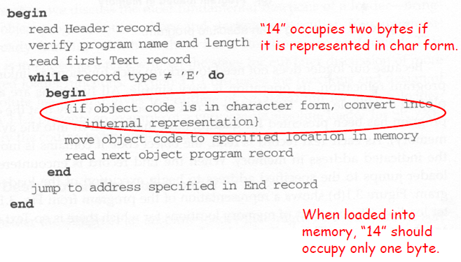
Absolute Loader Implementation
Systems Programming - V 3.0

Slide 20
Begin
read Header record
verify program name and length
read first Text record
while record type is <> ‘E’ do
begin
{if object code is in character form, convert into internal representation}
move object code to specified location in memory
read next object program record
end
jump to address specified in End record
end
Systems Programming - V 3.0

Slide 21
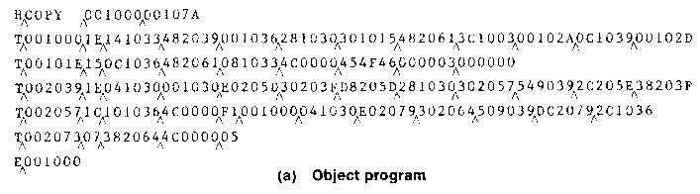
OBJECT PROGRAM
Systems Programming - V 3.0

Slide 22
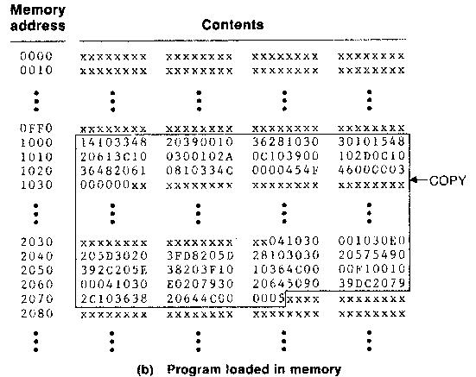
Format-1(a) (in PowerPoint)
Space for
2 inch x 2 inch
size Picture
Space for
2 inch x 2 inch
size Picture
Systems Programming - V 3.0

Slide 23
OBJECT CODE REPRESENTATION
  Each byte of assembled code is given using its
  hexadecimal representation in character form
  Easy to read by human beings
  Each byte of object code is stored as a single byte
  Most machine store object programs in a binary
  form
Systems Programming - V 3.0

Slide 24
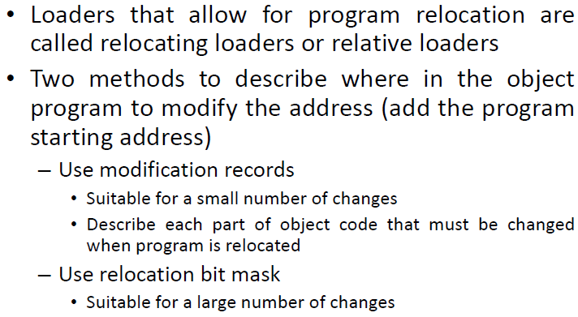
Relocating Loader
Systems Programming - V 3.0

Slide 25
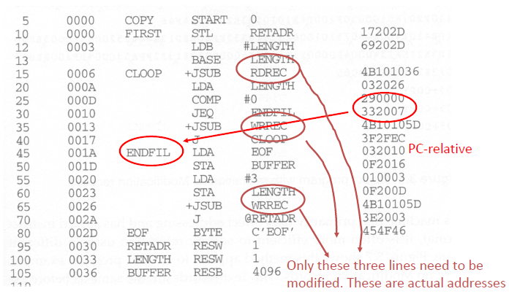
Program Written in SIC/XE
Systems Programming - V 3.0

Slide 26
A SIMPLE BOOTSTRAP LOADER
  When a computer is first tuned on or restarted, a special type of absolute loader, called bootstrap loader is executed
  This bootstrap loads the first program to be run by the computer -- usually an operating system
Systems Programming - V 3.0

Slide 27
EXAMPLE (SIC BOOTSTRAP LOADER)
  The bootstrap itself begins at address 0
  It loads the OS starting address 0x80
  No header record or control information, the object code is consecutive bytes of memory
Systems Programming - V 3.0

Slide 28
BOOTSTRAP LOADERS
How is the loader itself loaded into the memory ?
When computer is started – with no program in memory, a program present in ROM ( absolute address) can be made executed – may be OS itself or A Bootstrap loader, which in turn loads OS and prepares it for execution.
The first record ( or records) is generally referred to as a bootstrap loader – makes the OS to be loaded
Such a loader is added to the beginning of all object programs that are to be loaded into an empty and idle system
Systems Programming - V 3.0

Slide 29
Begin
X=0x80 (the address of the next memory location to be loaded
Loop
A←GETC (and convert it from the ASCII character code to the value of the hexadecimal digit)
save the value in the high-order 4 bits of S
A←GETC
combine the value to form one byte A← (A+S)
store the value (in A) to the address in register X
X←X+1
End
Systems Programming - V 3.0

Slide 30
SUBROUTINE GETC
GETC A←read one character
if A=0x04 then jump to 0x80
if A<48 then GETC
A ← A-48 (0x30)
if A<10 then return
A ← A-7
return
Systems Programming - V 3.0

Slide 31
SIC uses the above mentioned second method.
The bootstrap begins at address 0 in the memory of the machine.
It loads the operating system at address 80.
Each byte of object code to be loaded is represented on device
F1 as two hexadecimal digits just as it is in a Text record of a SIC object program.
The object code from device F1 is always loaded into consecutive bytes of memory, starting at address 80.
Systems Programming - V 3.0

Slide 32
SIC uses the above mentioned second method.
The main loop of the bootstrap keeps the address of the next memory location to be loaded in register X.
After all of the object code from device F1 has been loaded, the bootstrap jumps to address 80, which begins the execution of the program that was loaded.
Systems Programming - V 3.0

Slide 33
MACHINE-DEPENDENT LOADER FEATURES
The features of loader that depends on machine architecture are called machine dependent loader features. It includes:
1. Program Relocation
2. Program Linking
Systems Programming - V 3.0

Slide 34
Program Relocation (Relocating Loader)
The absolute loader has several disadvantages. One of the most obvious is the need for the programmer to specify the actual address at which it will be loaded into memory.
On a simple computer with a small memory the actual address at which the program will be loaded can be specified easily.
On a larger and more advanced machine, we often like to run several independent programs together, sharing memory between them. We do not know in advance where a program will be loaded. Hence we write relocatable programs instead of absolute ones.
Systems Programming - V 3.0

Slide 35
Program Relocation (Relocating Loader)
Writing absolute programs also makes it difficult to use subroutine libraries efficiently. This could not be done effectively if all of the subroutines had preassigned absolute addresses.
The need for program relocation is an indirect consequence of the change to larger and more powerful computers. The way relocation is implemented in a loader is also dependent upon machine characteristics.
Program relocation is explained in Module 2
Systems Programming - V 3.0

Slide 36
RELOCATION
Execution of the object program using any part of the available and sufficient memory
The object program is loaded into memory wherever there is room for it
The actual starting address of the object program is not known until load time
Loaders that has the capability to perform relocation are called relocating loaders or relative loaders.
Systems Programming - V 3.0

Slide 37
RELOCATING LOADERS
There are two methods for specifying relocation in object program
1. Modification Record
2. Relocation Bit
Systems Programming - V 3.0

Slide 38
Modification Record
A Modification record is used to describe each part of the object code that must be changed when the program is relocated.
Systems Programming - V 3.0

Slide 39
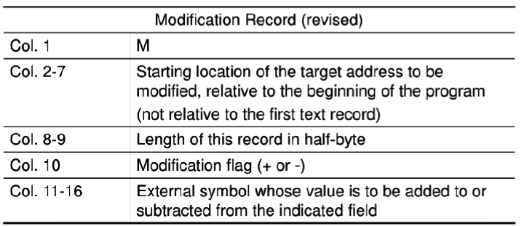
The Modification has the following format:
Each Modification record specifies the starting address and length of the field whose value is to be altered. It then describes the modification to be performed.
Systems Programming - V 3.0

Slide 40
H_{Λ}COPY _{Λ}000000 001077
T_{Λ}000000 _{Λ}1D_{Λ}17202D_{Λ}69202D_{Λ}48101036_{Λ}…_{Λ}4B105D_{Λ}3F2FEC_{Λ}032010
T_{Λ}00001D_{Λ}13_{Λ}0F2016_{Λ}010003_{Λ}0F200D_{Λ}4B10105D_{Λ}3E2003_{Λ}454F46
T_{Λ}001035 _{Λ}1D_{Λ}B410_{Λ}B400_{Λ}B440_{Λ}75101000_{Λ}…_{Λ}332008_{Λ}57C003_{Λ}B850
T_{Λ}001053_{Λ}1D_{Λ}3B2FEA_{Λ}134000_{Λ}4F0000_{Λ}F1_{Λ}.._{Λ}53C003_{Λ}DF2008_{Λ}B850
T_{Λ}00070_{Λ}07_{Λ}3B2FEF_{Λ}4F0000_{Λ}05
M_{Λ}000007_{Λ}05+COPY
M_{Λ}000014_{Λ}05+COPY
M_{Λ}000027_{Λ}05+COPY
E_{Λ}000000
Object program with relocation by Modification records
Systems Programming - V 3.0

Slide 41
RELOCATION BIT
To overcome the disadvantage of modification record, relocation bit is used.
The Text records are the same as before except that there is a relocation bit associated with each word of object code.
Since all SIC instructions occupy one word, this means that there is one relocation bit for each possible instruction.
The relocation bits are gathered together into a bit mask following the length indicator in each Text record.
Systems Programming - V 3.0

Slide 42
RELOCATION BIT
For simple machines
Relocation bit
  - 0: no modification is necessary
  - 1: modification is needed
Systems Programming - V 3.0

Slide 43
RELOCATION BIT
Twelve-bit mask is used in each Text record - col:10-12 – relocation bits
  - since each text record contains less than 12 words
  - unused words are set to 0
  - any value that is to be modified during relocation must coincide with one of these 3-byte segments - line 210
Systems Programming - V 3.0

Slide 44
RELOCATION BIT
H_{Λ}COPY _{Λ}000000 00107A
T_{Λ}000000_{Λ}1E_{Λ}FFC_{Λ}140033_{Λ}481039_{Λ}000036_{Λ}280030_{Λ}300015_{Λ}…_{Λ}3C0003 _{Λ} …
T_{Λ}00001E_{Λ}15_{Λ}E00_{Λ}0C0036_{Λ}481061_{Λ}080033_{Λ}4C0000_{Λ}…_{Λ}000003_{Λ}000000
T_{Λ}001039_{Λ}1E_{Λ}FFC_{Λ}040030_{Λ}000030_{Λ}…_{Λ}30103F_{Λ}D8105D_{Λ}280030_{Λ}...
T_{Λ}001057_{Λ}0A_{Λ} 800_{Λ}100036_{Λ}4C0000_{Λ}F1_{Λ}001000
T_{Λ}001061_{Λ}19_{Λ}FE0_{Λ}040030_{Λ}E01079_{Λ}…_{Λ}508039_{Λ}DC1079_{Λ}2C0036_{Λ}...
E_{Λ}000000
Object program with relocation by bit mask
- FFC - all ten words are to be modified
- E00 - first three records are to be modified
Systems Programming - V 3.0

Slide 45
PROGRAM LINKING
Goal - Resolve the problems with EXTREF and EXTDEF from different control sections
Use modification records for both relocation and linking
    - address constant
    - external reference
Systems Programming - V 3.0

Slide 46
EXTDEF (EXTERNAL DEFINITION
The EXTDEF statement in a control section names symbols, called external symbols, that are defined in this control section and may be used by other sections
Ex: EXTDEF BUFFER, BUFFEND, LENGTH (Refer Figure)
EXTDEF LISTA, ENDA (Refer Figure)
Systems Programming - V 3.0

Slide 47
EXTREF (EXTERNAL REFERENCE)
The EXTREF statement names symbols used in this (present) control section and are defined elsewhere
  Ex: EXTREF RDREC, WRREC (Refer Figure) EXTREF LISTB, ENDB, LISTC, ENDC (Refer Figure)
Systems Programming - V 3.0

Slide 48

Systems Programming - V 3.0

Slide 49

IMP Note to Self
Systems Programming - V 3.0

